Slide 1
The Renowned Sky Sights Charter Company
Created by: Hunter Haapala, Jonathan Cross, Thomas Thompson and Jasin Gettel

Slide 2
Leading up to the Database

Slide 3
What is the DB Charter Company Known for?
Before being rebranded as the Database Charter Company, this company was a small-time aviation company that kept all its information physical instead of digital. After growing in size and popularity, the company realized it needed update logs of all their employees, their codes and qualifications, along with keeping these qualifications up to date, and assigning testing to employees to renew any licenses or certifications, and keeping the testing codes and dates properly updated. Other aspects, like flight durations, types of aircraft, the different customers, the different roles employees specifically filled vs. qualified for, and so much more came up when looking into what needed to be changed. With this in mind, the company revamped with a Database to keep all this errant information in track!

Slide 4
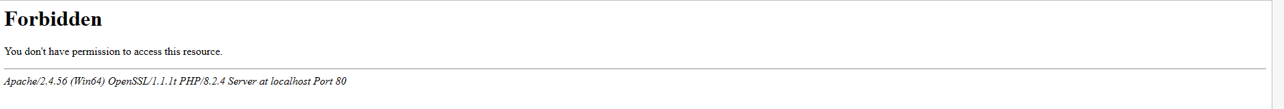


Some Problems…

Slide 5


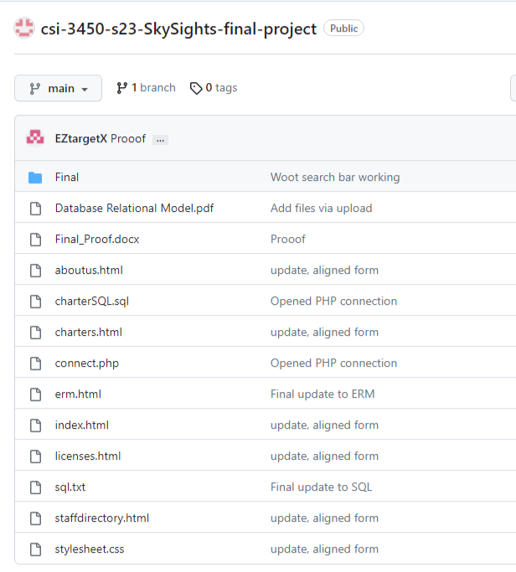

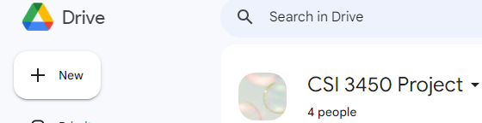
Resources Used
HTML, and CSS (BootStrap)
MySQL and PHP through XAMPP
GitHub
Discord
Google Drive
Lucid Chart

Slide 6
Rules, Relationships, and Regulations

Slide 7
Some ‘Air’ Rules
A customer may request many charter trips
Each trip is requested by one customer
An employee may be assigned to serve as a crew member on many charter trips
Each trip may have many employees assigned as crew members
Charter flights take place once a customer reserves the use of an aircraft at a designated date and time to fly to one or multiple designated areas
Customers may pay the bill upfront, or put it as a charge to their charter account
The amount of the charge cannot exceed the available credit
A crew may consist of one or more personnel, and not all crew members are pilots (i.e. Loadmasters, Flight Attendants, etc.)
Pilots are required to generate a record for each charter trip
All employees are required to complete proper training, pass tests, and receive the correct license and certifications
Employees aren’t restricted to one crew member certification
A monthly summary of all charter trips, revenues, and expenses is generated from the charter records

Slide 8
Attributes
EMP_CODE - Employee Code - INT
EMP_FNAME - Employee First Name - STRING
EMP_LNAME - Employe Last Name - STRING
INSTRU_RATING - Instrument Rating - INT
MEL - Multi Engine Land Aircraft Rating - FLOAT
LM - Loadmaster - STRING
FA - Flight Attendant - STRING
CERT - Certification Type - STRING
LIC - License Type - STRING
LIC_DATE - Date of License Acquired - DATE
CERT_DESC - Description of Certification - STRING
CERT_DATE - Date of Certification Acquired - DATE
TEST_CODE - Test Code - INT
TEST_DESC - Description of Test - STRING
TEST_LAST_TEST_DONE - Date of Last Test Completion - DATE
TEST_NEXT_TEST_DUE - Date of next Test Due - DATE
TEST_RSLT - Result of Test(s) - STRING
CHARTER_NUM - Number of Charter Flight - INT
PILOT_CODE - Pilot Code - INT
CHARTER_TRIP_LENGTH - Time Charter Trip Should Take - INT
CHARTER_COSTS - Cost of Charter Trip - INT
CHARTER_REVENUE - Revenue Earned from Charter Trip - INT
CUS_ACCOUNT_NUM - Customers Unique Account Number - INT
CUS_BALANCE_DUE - Customers Outstanding Balance - INT
CUS_REQ - Any Special Customer Requirements - STRING
Entities
Employees
EMP_CODE
EMP_FNAME
EMP_LNAME
CERT or LIC
Results
TEST_CODE
TEST_DESC
TEST_LAST_TEST_DONE
TEST_NEXT_TEST_DUE
TEST_RSLT
Charter Trip
CHARTER_NUM
PILOT_CODE
CHARTER_TRIP_LENGTH
CHARTER_COSTS
CHARTER_REVENUE
Customer
CUS_ACCOUNT_NUM
CUS_BALANCE_DUE
CUS_REQ
Attributes and Entities

Slide 9
Data Dictionary
Table Name | Attribute Name | Contents | Type | Format | Range | Required | PK or FK | FK Reinforced Table
Employee | EMP_CODE | Employee’s Account Code | INT | 9999 | 0001-9999 | Y | PK
 | EMP_FNAME | Employee’s First Name | STRING | Xxxxx |  | Y
 | EMP_LNAME | Employee’s Last Name | STRING | Xxxxx |  | Y
 | CERT | Employee’s License/Certification | STRING | xxxxxx |  | Y
Results | TEST_CODE | Test Employee Code | INT | 9999 | 0001-9999 | N | FK | Employee
 | TEST_DESC | Test Description | STRING | xxxxxx |  | N
 | TEST_LAST_TEST_DONE | Test of last test finished by Employee | STRING | xxxxx |  | Y | FK | Employee
 | TEST_NEXT_TEST_DATE | Date of next test to be finished by Employee | STRING | xxxxx |  | Y | FK | Employee
 | TEST_RSLT | Test results of Employee | STRING | xxxxx |  | Y

Slide 10
Data Dictionary Continued
Charter Trip | CHARTER_NUM | Number code of Charter Trip | INT | 9999 | 0001-9999 | Y
 | PILOT_CODE | Pilot code | INT | 9999 | 0001-9999 | Y
 | CHARTER_TRIP_LENGTH | The length of the Charter Trip | TIME | 9:99 | 0:00-999:999 | Y
 | CHARER_COSTS | The cost of a Charter Trip | MONEY | $9999.99 | $0.0-9999.99 | Y
 | CHARTER_REVENUE | Revenue achieved by charters. | MONEY | $9999.99 | $0.0-9999.99 | Y
Customer | CUS_ACCOUNT_NUM | A Customer’s account number/code | INT | 9999 | 0001-9999 | Y
 | CUS_BALANCE_DUE | A Customer’s balance due | MONEY | $9999.99 | $0.0-9999.99 | Y
 | CUS_REQ | A Customer’s special requirement(s) | STRING | xxxxx |  | N

Slide 11
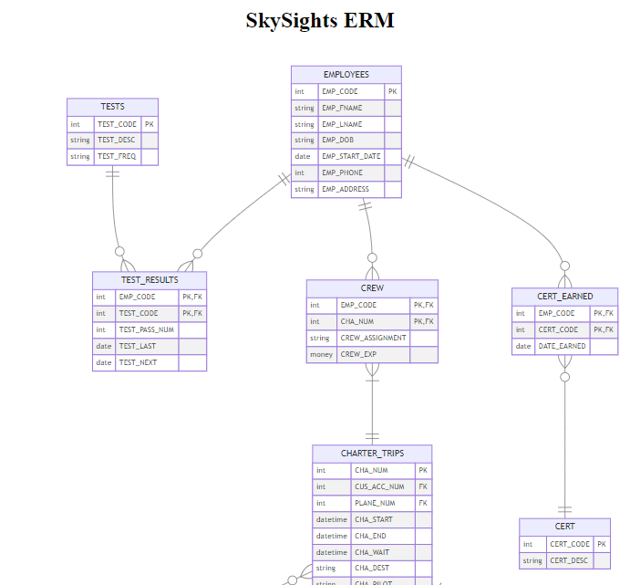

Slide 12
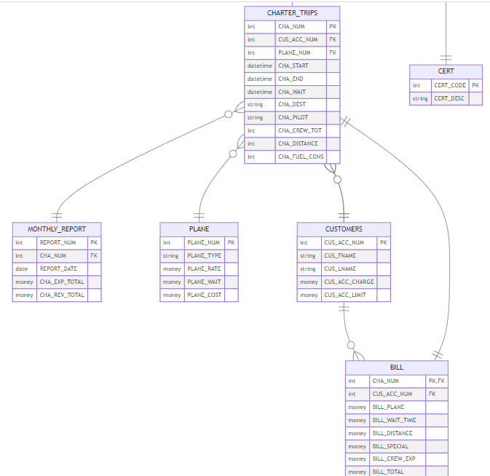

Slide 13
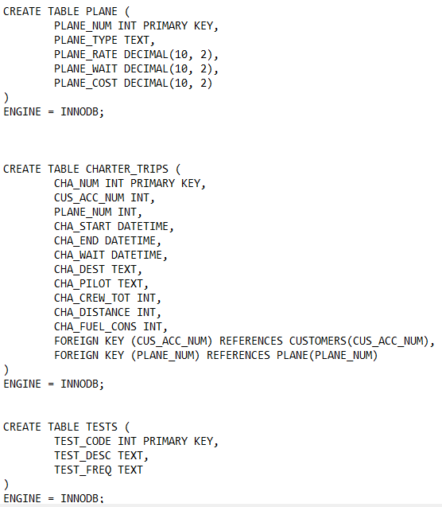
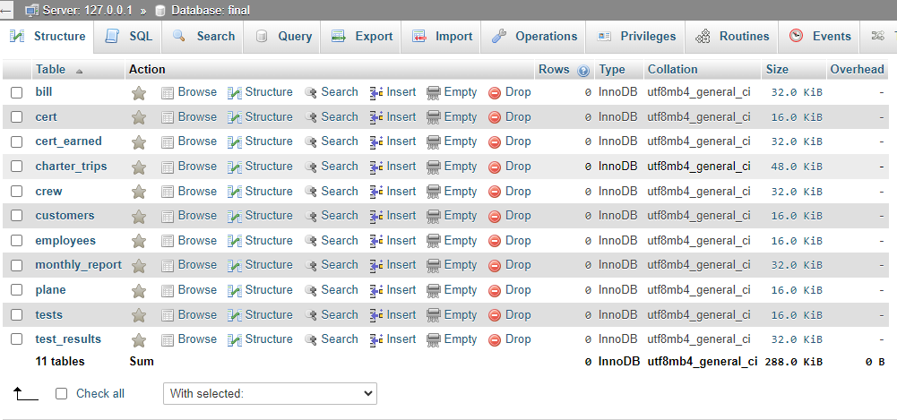

Slide 14
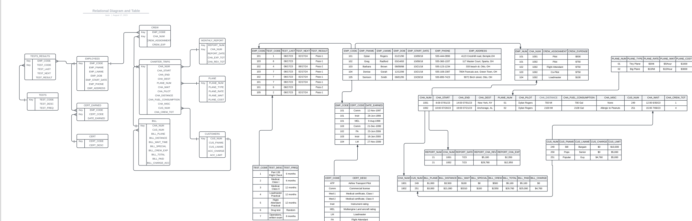

Slide 15
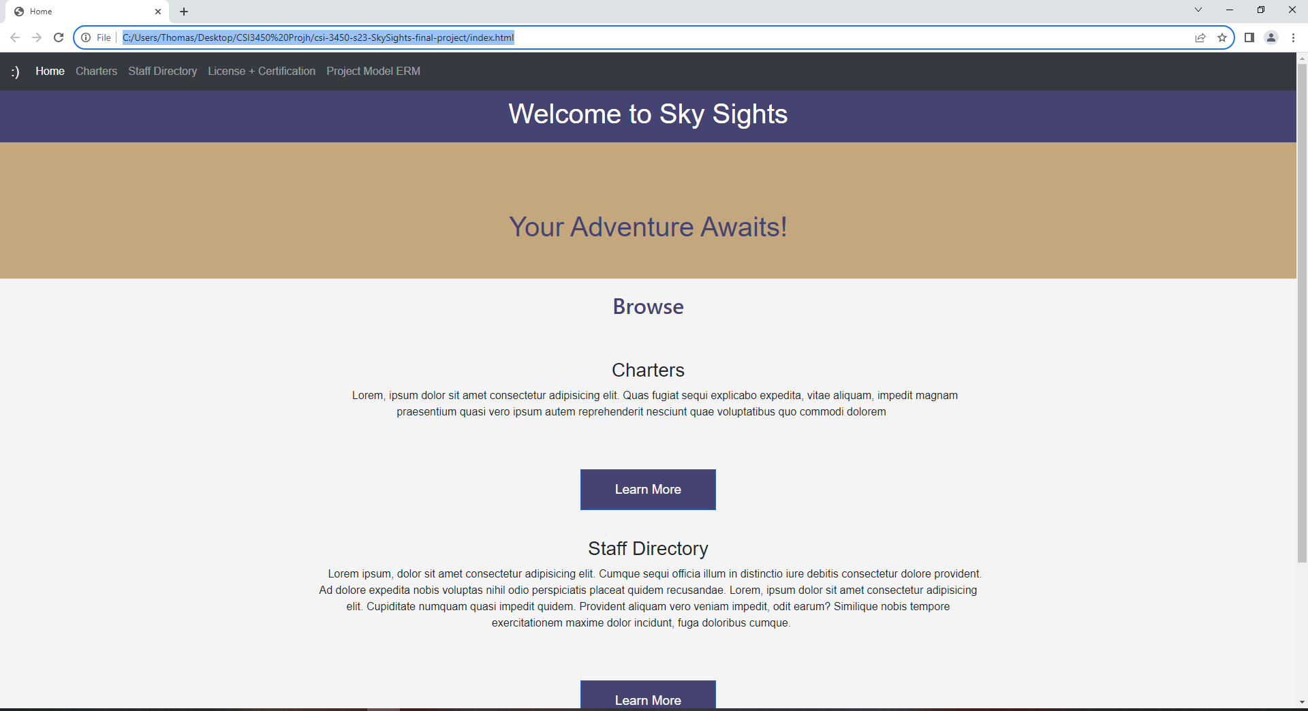
Front End

Slide 16
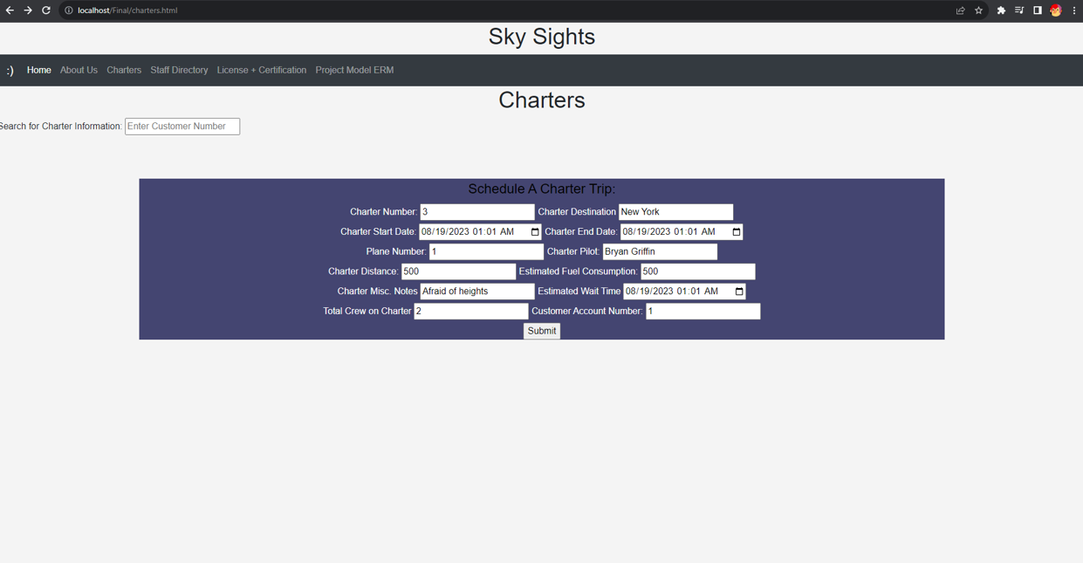
Front End (Cont.)

Slide 17
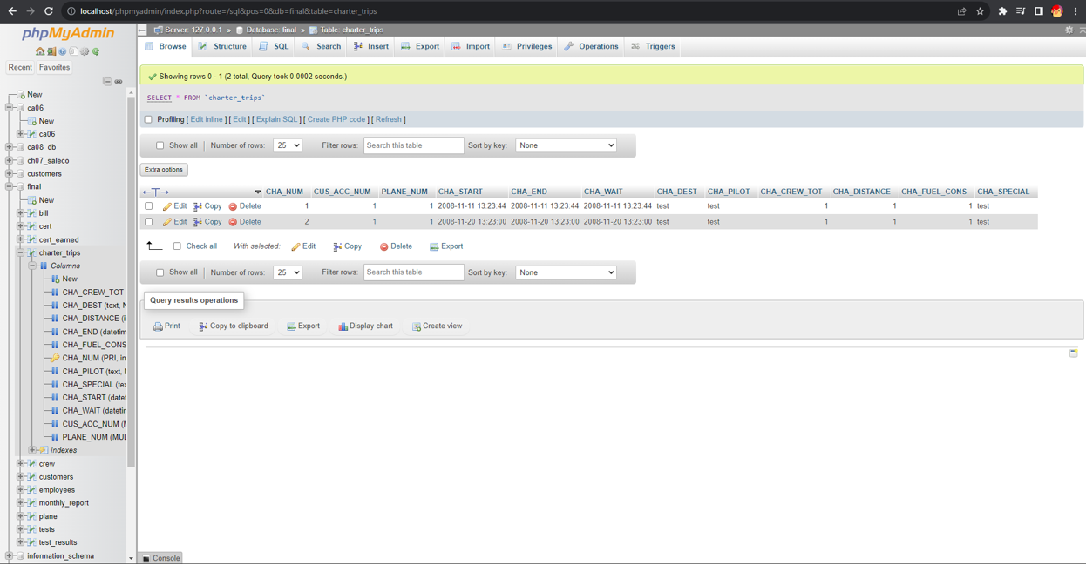

Slide 18
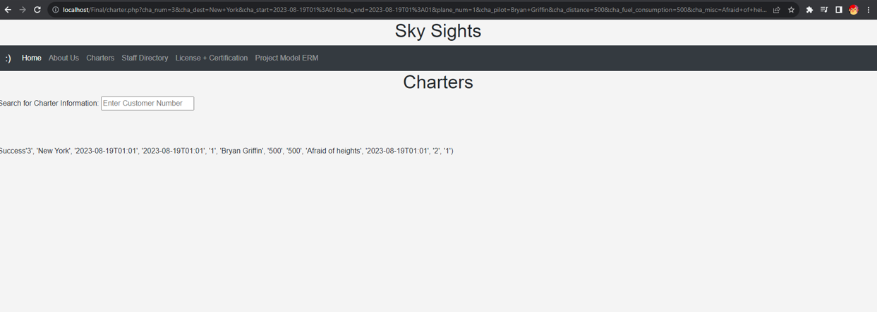

Slide 19
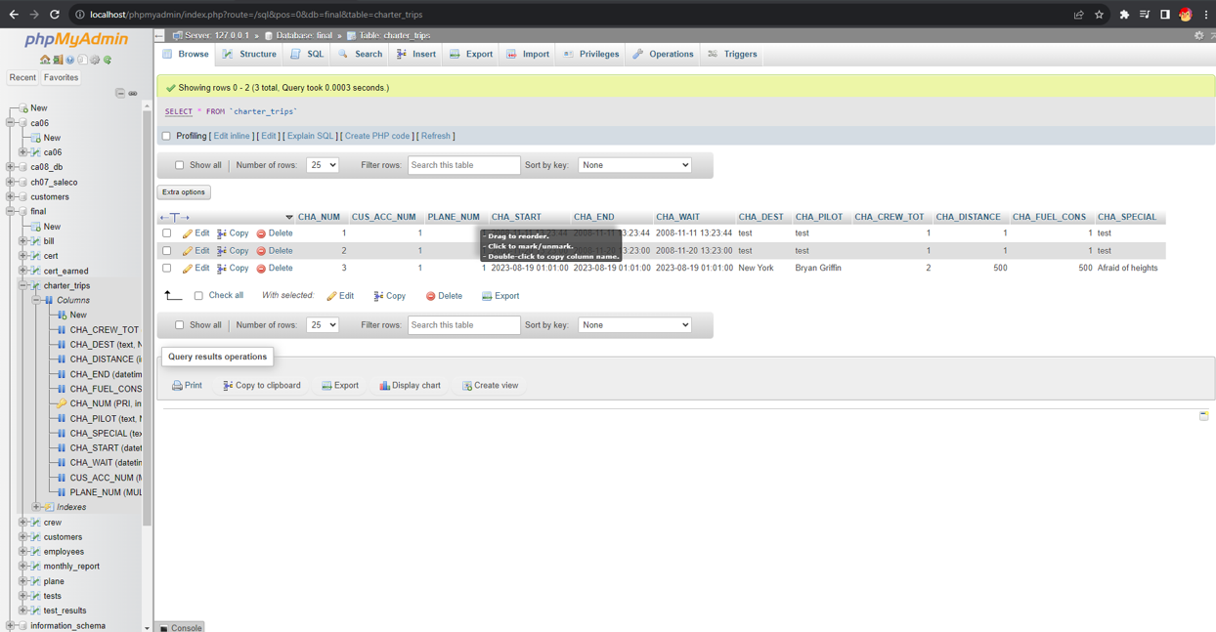

Slide 20
